Slide 1
Data Visualization of Bird Strikes between 2000 – 2011
Project 2

Slide 2
Introduction
Transport and communication are in the crucial domain in the field of analytics.
Environmental impacts and safety are, nowadays, two major concerns of the scientific
community with respect to transport scenarios and to the ever-growing urban areas.
These issues gain more importance due to the increasing number of vehicles and
people. Seeking new solutions is reaching a point where available technologies and
artificial intelligence, especially MAS, are being recognized as ways to cope with and
tackle these kinds of problems in a distributed and more appropriate way.
A bird strike is strictly defined as a collision between a bird and an aircraft which is in
flight or on a take-off or landing roll. The term is often expanded to cover other wildlife
strikes - with bats or ground animals. Bird Strike is common and can be a significant
threat to aircraft safety. For smaller aircraft, significant damage may be caused to the
aircraft structure and all aircraft, especially jet-engine ones, are vulnerable to the loss
of thrust which can follow the ingestion of birds into engine air intakes. This has
resulted in several fatal accidents.
Bird strikes may occur during any phase of flight, but are most likely during the
take-off, initial climb, approach and landing phases due to the greater numbers of birds
in flight at lower levels. To have a closer look the following document visually depicts
the data collected on Bird Strikes by FAA between 2000-2011.

Slide 3
Problem Case Studies
● Visuals Depicting the Number of Bird Strikes
● Yearly Analysis & Bird Strikes in the US
● Top 10 US Airlines in terms of having encountered bird strikes
● Airports with most incidents of bird strikes – Top 50
● Yearly Cost Incurred due to Bird Strikes:
● When do most bird strikes occur?
● Altitude of airplanes at the time of strike
● Phase of flight at the time of the strike.
● Average Altitude of the airplanes in different phases at the time of strike.
● Effect of Bird Strikes & Impact on Flight
● Effect of Strike at Different Altitude
● Were Pilots Informed? & Prior Warning and Effect of Strike Relation

Slide 4
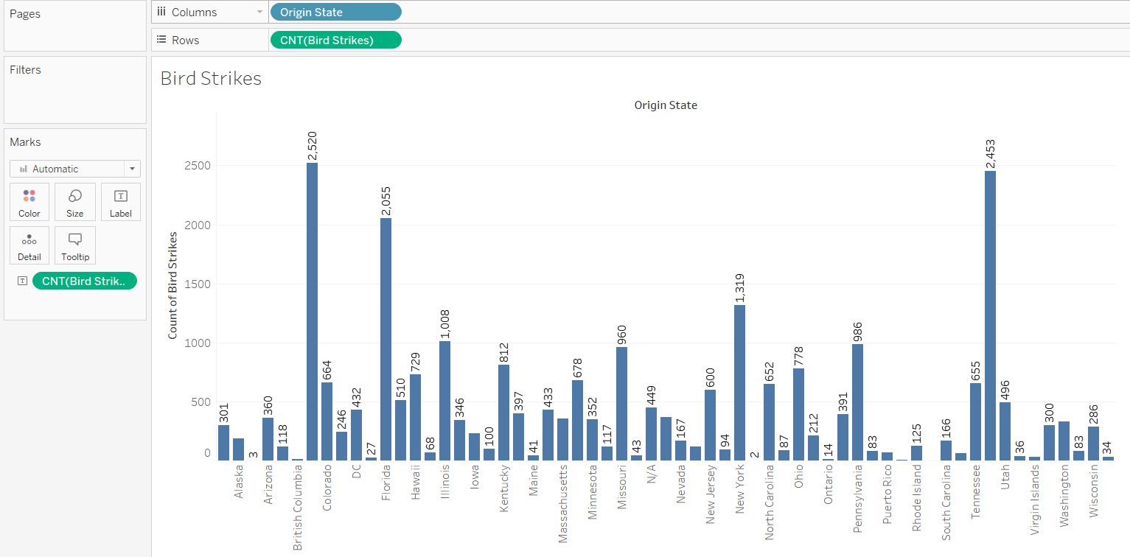
Visuals Depicting the Number of Bird Strikes
The visuals depicting the number of bird strikes show that California is the topmost state with highest number of bird strikes in the US . It is closely followed by Texas , with a total of 2543 bird strikes in the US.
The state with the least number of bird strikes is Saskatchewan , with a total of just 1 bird strike overall.

Slide 5
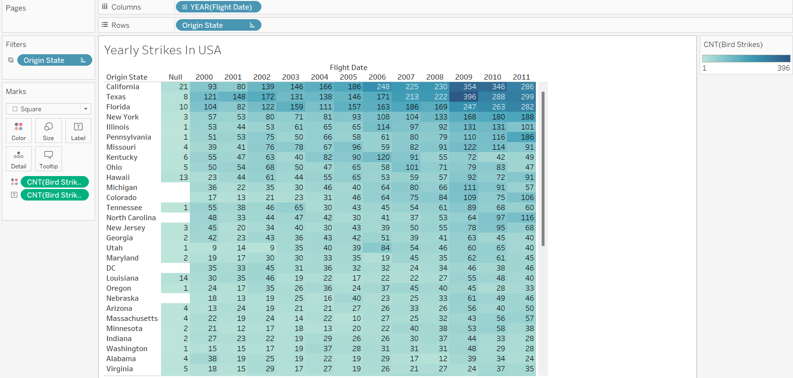
Yearly Analysis & Bird Strikes in the US
The yearly analysis of bird strikes in the US shows that Texas showcased highest number of bird strikes in the US in the year 2009. It was closely followed by California with a bird strike of 354 and 346 in the year 2009 and 2010 respectively.

Slide 6
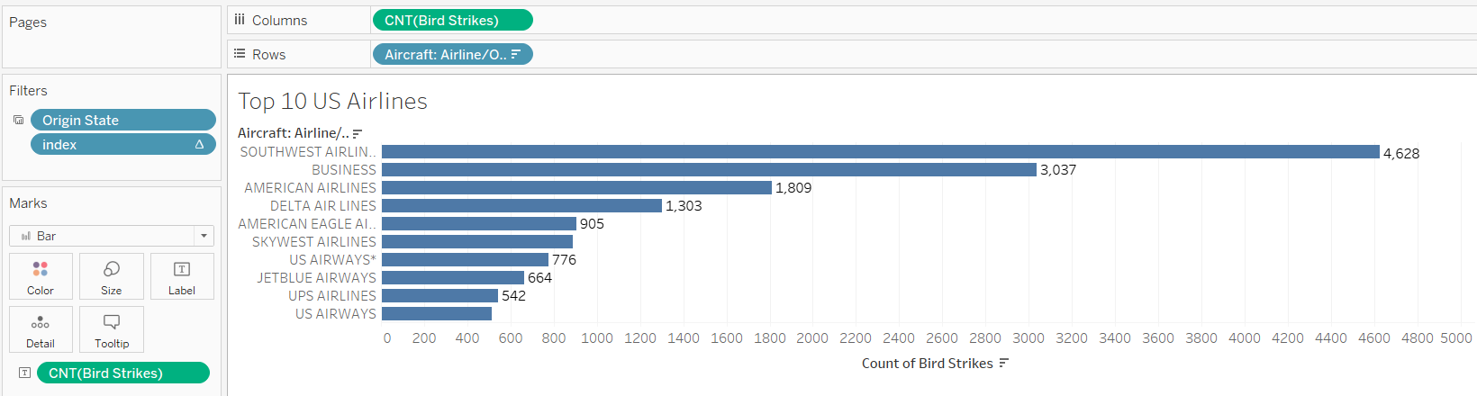
Top 10 US Airlines in terms of having encountered bird strikes
Southwest Airlines tops the list of “The top 10 US Airlines in terms of having encountered bird strikes”, with a total of 4628 strikes.
It is followed by Business Airlines with a total bird strike of 3037 strikes overall.
The US Airways bottoms the list with a total of 511 strikes overall.

Slide 7
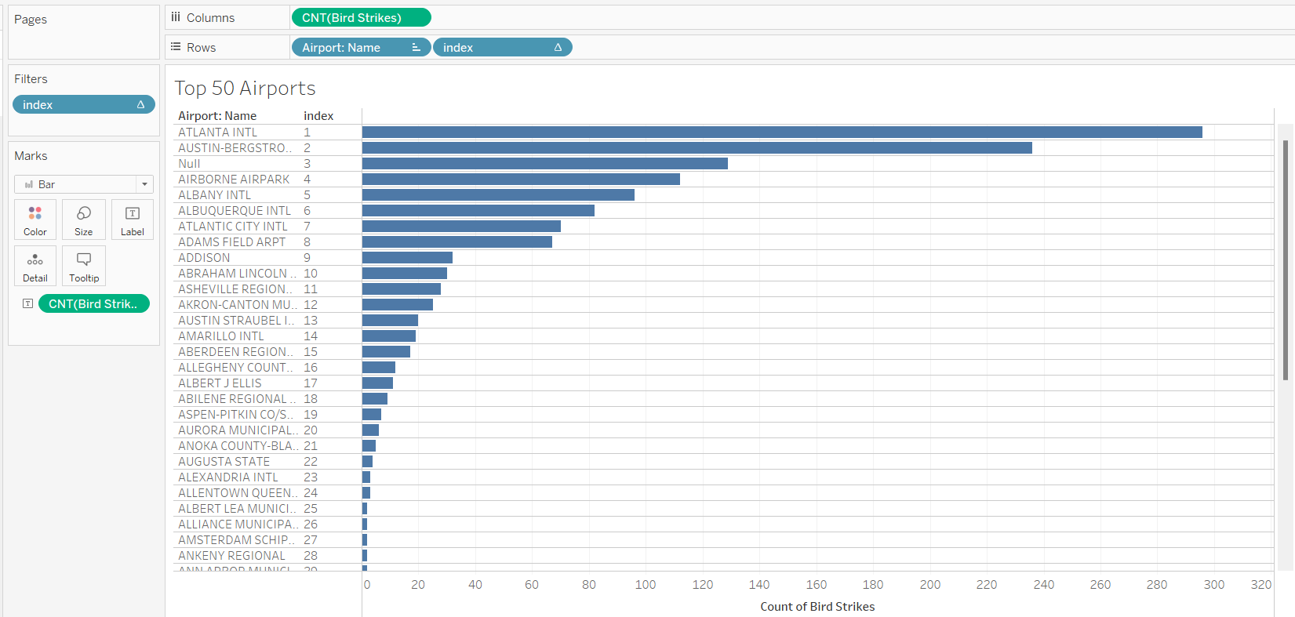
Airports with most incidents of bird strikes – Top 50
Atlanta Intl Airport tops the list with a total of 296 bird strikes.
Austin Bergstrom Airport is the second most airport with a total of 236 bird strikes.

Slide 8
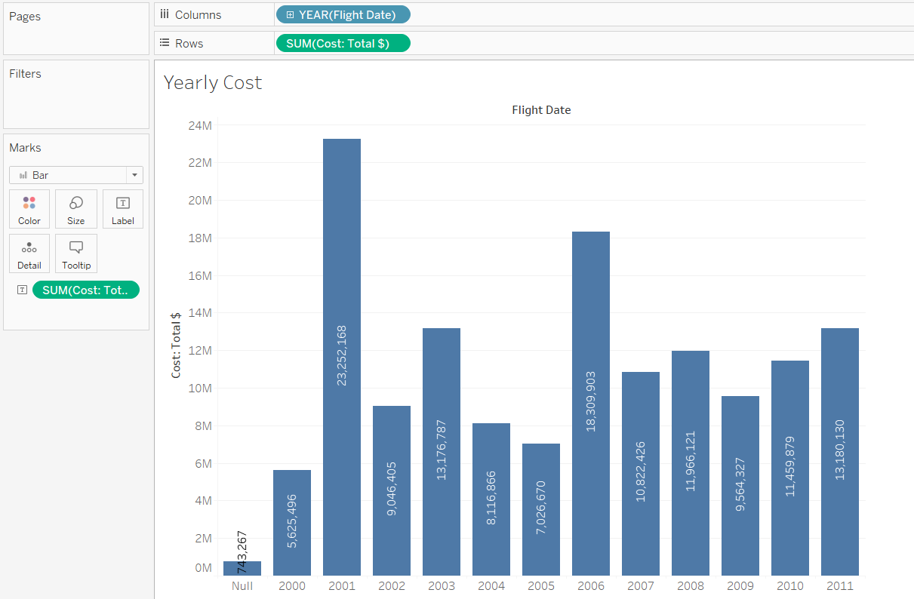
Yearly Cost Incurred due to Bird Strikes:
The highest yearly cost incurred due to bird strikes is 23.25M in the year 2001.
The lowest yearly cost incurred due to bird strikes ( apart from null values ) is 5.6M in the year 2000.

Slide 9
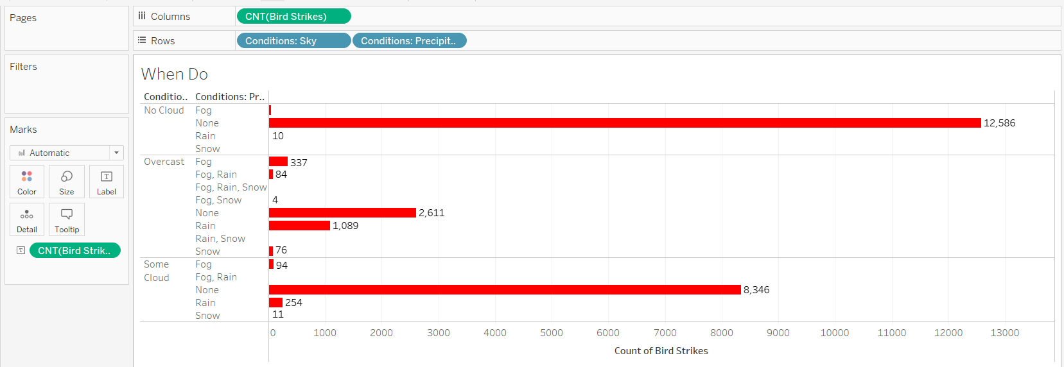
When do most bird strikes occur?
The majority of the bird strikes occur with sky condition of no clouds and no precipitation, as depicted in the chart above.
It was followed by sky conditions with some clouds, and no precipitation.

Slide 10
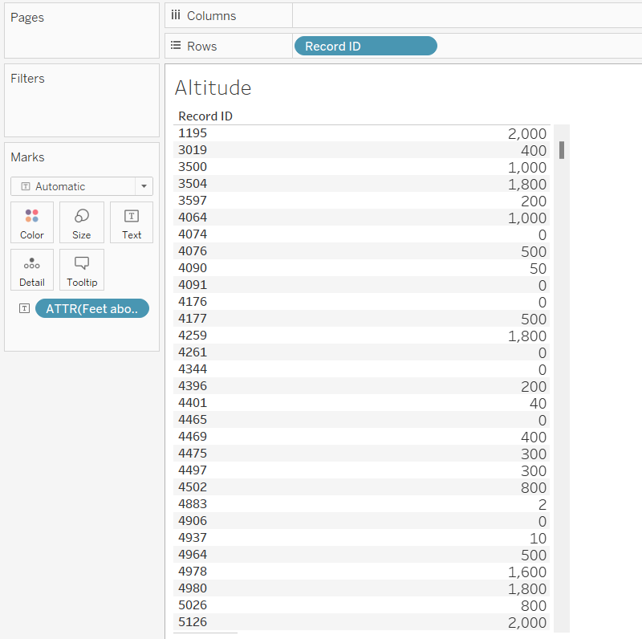
Altitude of airplanes at the time of strike
Looking at the graph depicting the altitudes of planes at the time of airstrike, the altitude varies with bird strike count increasing and decreasing accordingly.
Attribute of feet above ground is taken to plot the values of birs strikes .

Slide 11
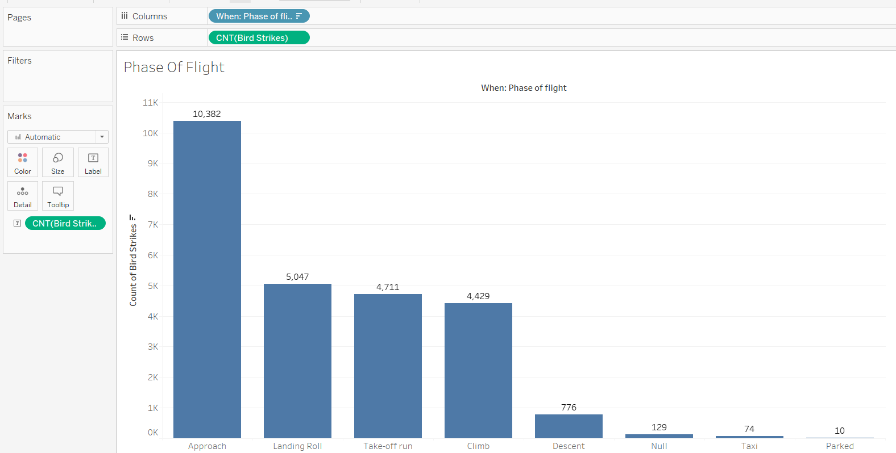
Phase of flight at the time of the strike.
The graph shows the phase of flight when the flight encounters the bird strike. We can see that the majority phase is when the flight is in its Approach Phase and least when it is parked.
The Approach phase – 10,382 strikes
The Parked phase – 10 strikes

Slide 12
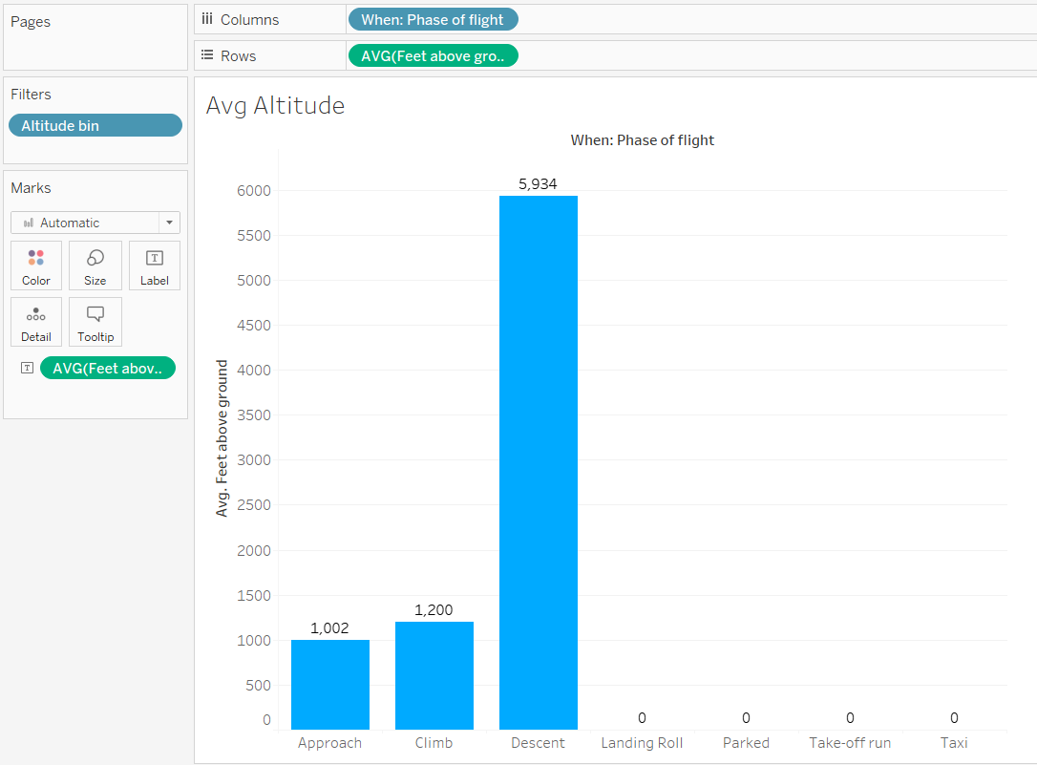
Average Altitude of the airplanes in different phases at the time of strike
The graph shows the average altitude of the airplanes in different phases at the time of strike. We can see that the phase with highest number of bird strikes is Descent Phase with an average of 5934 feet above ground altitude.

Slide 13
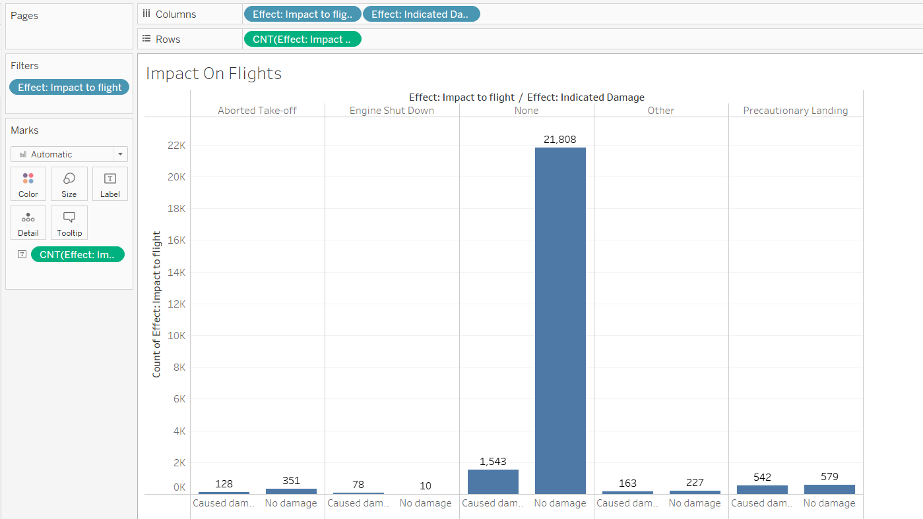
Effect of Bird Strikes & Impact on Flight
The graph shows the effects of bird strikes and impact of them on the flight. We can see that some of the effects include - Aborted takeoff , Engine shutdown , Precautionary Landing etc. The highest number accounts to when no damage occur and the flight has no impact due to the bird strikes.

Slide 14
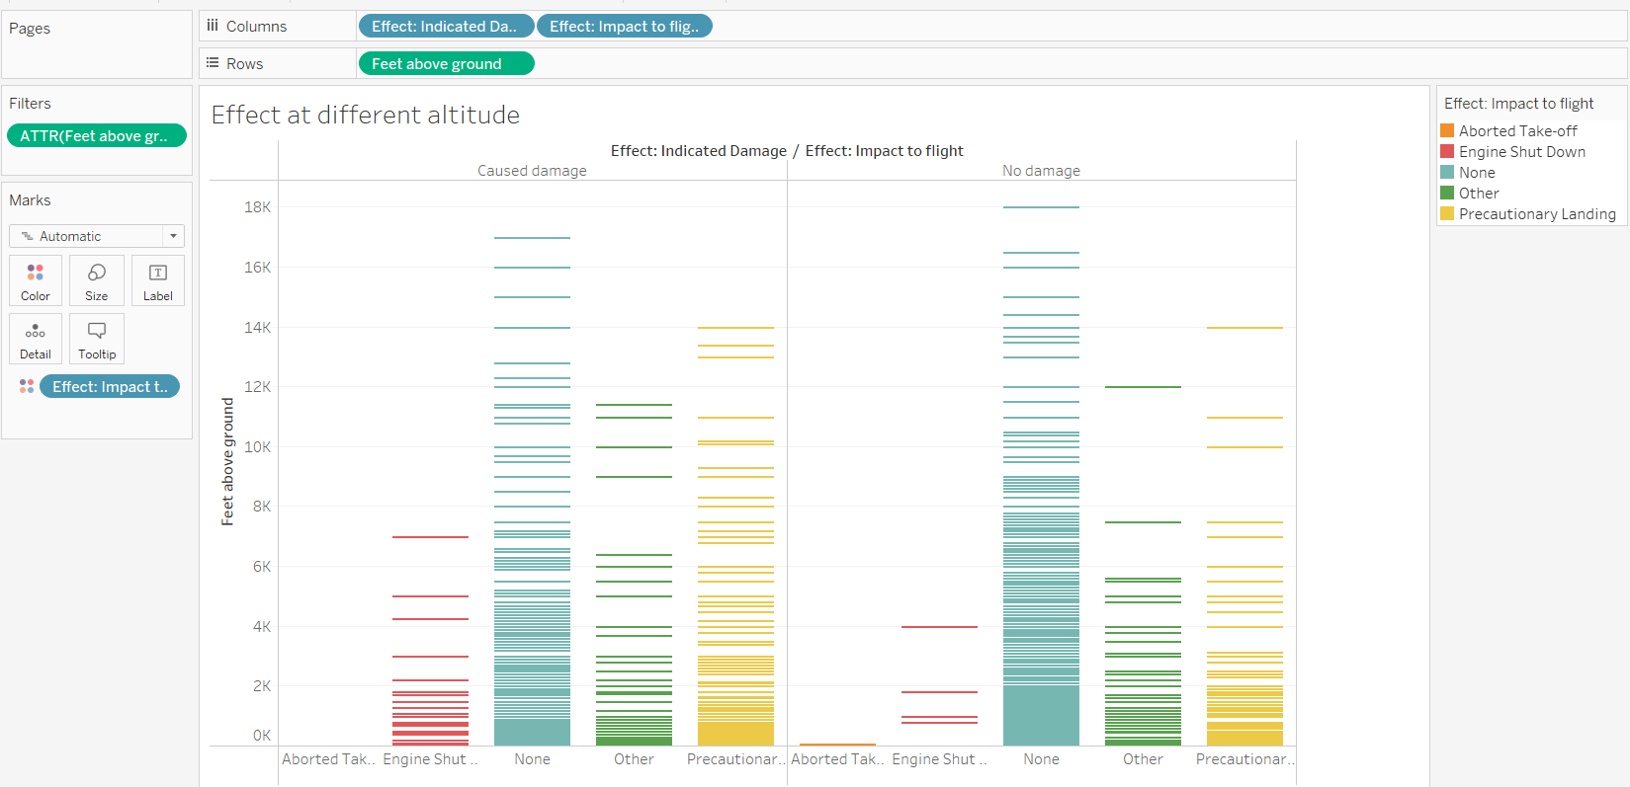
Effect of Strike at Different Altitude
The graph shows the effect of strike at different altitudes. Several Impact includes - Aborted takeoff , Engine shutdown , Precautionary Landing etc.
We can see while majority data shows no damage was caused but few cases show otherwise.

Slide 15
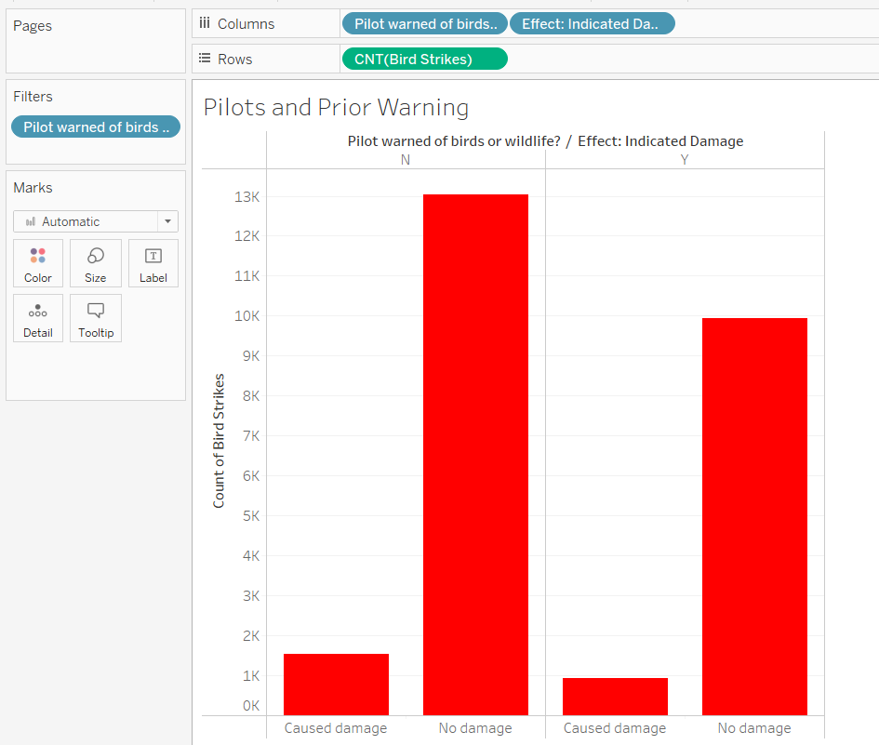
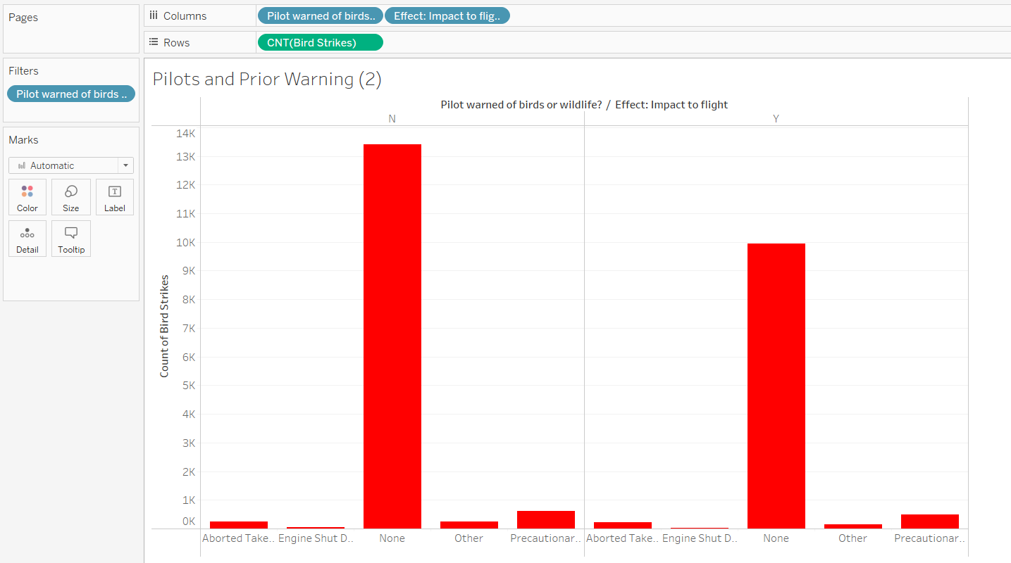
Were Pilots Informed? & Prior Warning and Effect of Strike Relation
The graph depicts that after the pilot was informed about the bird strike , the damage risk had severely decreased to 9,940 from 13,035. This shows that approx. .2% of bird strike damage can be delt with if the pilot is informed about possible bird strikes.

Slide 16
BY – SAMIYA BAKSHI samiyabakshi589@gmail.com
THANKYOU

